Slide 1
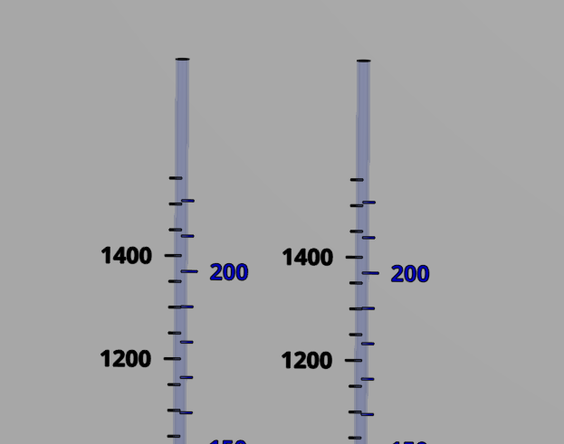
Coagulant
Chlorine
Stock tank
(L)
Calibration column
(mL)
Stock tank
(L)
Calibration column
(mL)

Slide 2
